Slide 1
Overview of sample e-questionnaire created by SBJ
June 2020

Slide 2

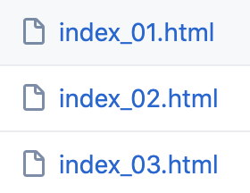

Creation flow
Multiple pages
1A
1A&1A2
e-Survey
Management
Customize
Merge
e-questionnaire
Builder
DDFDQ
Sigle page
1A2
DDFDQ
DDFDQ

Slide 3
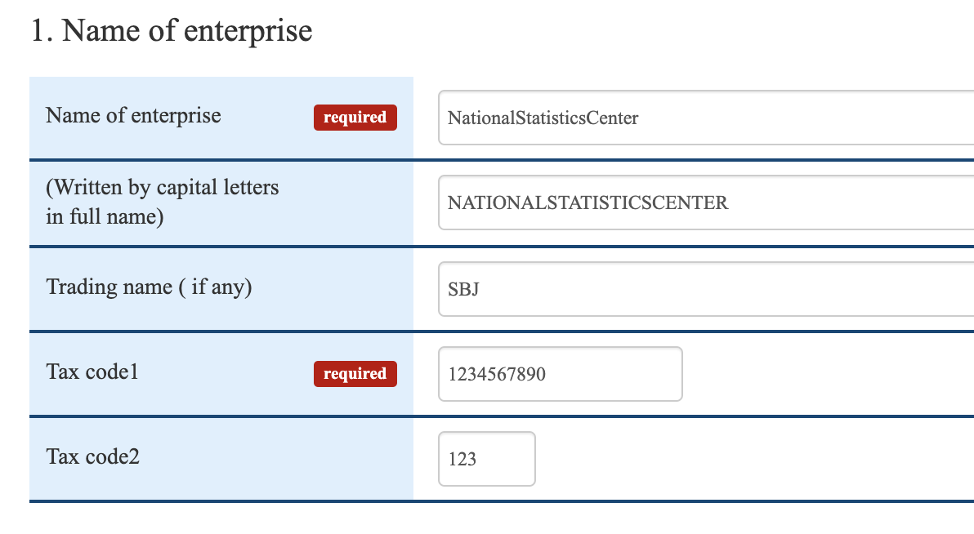
Processing at page load
Chosahyo.js
function CmnEmbedData(){
//Set initial data
// Province data(NSTAC Customize 2019-12)
if (questinnaire_id == "1A-1") {
…..
for (var i = 0; i < prov_1A.options.length; i++) {
if (prov_1A.options[i].value == strdata_array["F1A_2_Province"])
…...
}
for (var data_key in strdata_array) {
var elements = document.getElementsByName(data_key);
…...
}
Index_01.html
<body onload="CmnEmbedData();">
<script type="text/javascript">
var strdata_array = {
'F1A_1_Name_Ent': 'NationalStatisticsCenter',
'F1A_1_Name_Ent_CL': 'NATIONALSTATISTICSCENTER',
'F1A_Name_Ent_Trad':'SBJ',
'F1A_1_TaxCode_Ent':'1234567890',
'F1A_1_TaxCode_Estb':'123',
…...
}
</script>
This is inserted by the e-Survey server

Slide 4


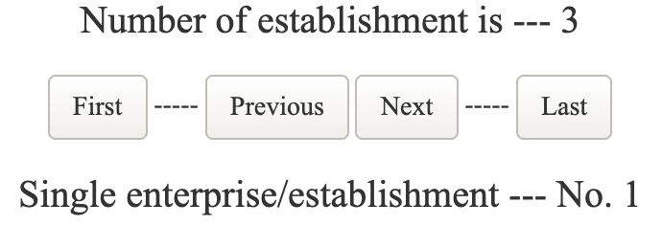
Multi-page flow
Index_01.html
Index_03.html
POST
onclick="pager(document.forms[0], actname_send_page, '03')"
POST
onclick="pager(document.forms[0], actname_send_page, '10')"
// Pager
function pager(iForm, iAction, iPageNum) {
if (checkController(iForm)) {
CmnSendPage(iForm, iAction, iPageNum);
}
<script type="text/javascript">
var strdata_array = {
'F1A_12_estab_01_1_2': '3',
'F1A_12_estab_01_1_2_prev': '4',
}
</script>
Chosahyo.js
Index_10.html
This is inserted by the e-Survey server

Slide 5
Multi-page flow for establishment
estb_ini.js
function estb_init(estb_max, estb_prev, prov){
estb_clear(estb_max);
var data = $("#estb_temp");
if (estb_max < estb_prev){
var loop_cnt = estb_prev;
}
else {
var loop_cnt = estb_max;
} …...
for (var wk_cnt = 1; wk_cnt <= loop_cnt; wk_cnt++) {
var data_wrk = $(data).clone().attr('id', wk_cnt + "-estb_view");
append_quest(wk_cnt, data_wrk);
…...
function estb_clear(estb_cnt) {
for (var key in strdata_array) {
…...
if (est[1] > estb_cnt) {
delete strdata_array[key];
}
function append_quest(wk_cnt, data_ins) {
$(data_ins).find('input').each(function () {
var id_c = wk_cnt + '-' + $(this).attr('id');
var name_c = "Es-" + wk_cnt + '-' + $(this).attr('name’);
…...
$(this).attr('id', id_c);
})
…...
}
<script type="text/javascript">
var strdata_array = {
'F1A_12_estab_01_1_2': '3',
'F1A_12_estab_01_1_2_prev': '4',
}
</script>
function CmnEmbedData(){
if (questinnaire_id == "1A2") {
estb_total = strdata_array["F1A_12_estab_01_1_2"];
var estb_prev = strdata_array["F1A_12_estab_01_1_2_prev"];
strdata_array["F1A_12_estab_01_1_2_prev"] = estb_total;
estb_init(estb_total, estb_prev, '1A2');
…...
}
Chosahyo.js
<!-- Template HTML Strat -->
<div id="estb_temp" class="" style="display: none;">
<div class="form-group form-inline tokei-table-tr clearfix">
<label for="taxcode1" class="control-label col-sm-2 tokei-table-th">
<span class="txt-label">Tax code1</span><span class="icons"></span></label>
<div class="col-sm-10 tokei-table-td">
<input type="text" id="taxcode1" name="F1A_1_TaxCode_Ent”
class="form-control tokei-textbox-item w150 no-name"
placeholder="" disabled style="font-size:12px; text-align:left">
</div>
…...
Index_10.html

Slide 6
Multi-page flow for establishment
function estb_pager(act, chk, page) {
if (chk) {
if (!(checkController(document.forms[0]))) {
return;
}
}
switch (act) {
case "first":
$("#" + estb_page + "-estb_view").css("display", "none");
$("#1-estb_view").css("display", "block");
estb_page = 1;
$("#estb_num_h").text(estb_page);
$("#estb_num_f").text(estb_page);
break;
case "next":
if (estb_page < estb_total) {
$("#" + estb_page + "-estb_view").css("display", "none");
estb_page = estb_page + 1;
$("#" + estb_page + "-estb_view").css("display", "block");
$("#estb_num_h").text(estb_page);
$("#estb_num_f").text(estb_page);
}
break;
case "prev":
if (estb_page > 1) {
$("#" + estb_page + "-estb_view").css("display", "none");
estb_page = estb_page - 1;
$("#" + estb_page + "-estb_view").css("display", "block");
$("#estb_num_h").text(estb_page);
$("#estb_num_f").text(estb_page);
}
break;
estb_ini.js
<button id="estb_btn_first_h" type="button" onclick="estb_pager('first',false)">First</button>
<button id="estb_btn_next_h" type="button"
onclick="estb_pager('next',false)"> Next </button>
<button id="estb_btn_prev_h" type="button" onclick="estb_pager('prev',false)">Previous</button>
Index_10.html

Slide 7
Merge html (01.html <-- 02.html, 03.html)
1A&1A2
New 1A&1A2
int_pager.js
Add
e-Survey
Management
Merge
DDFDQ

Slide 8
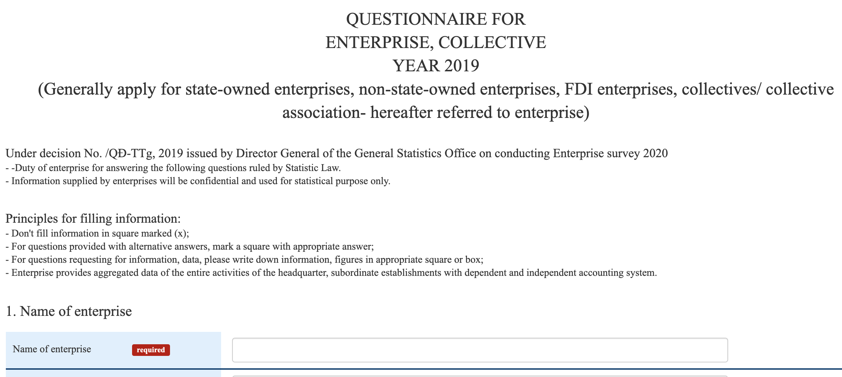
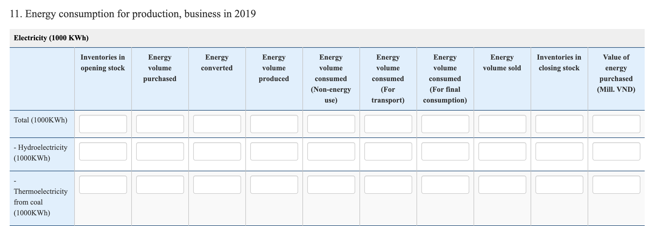
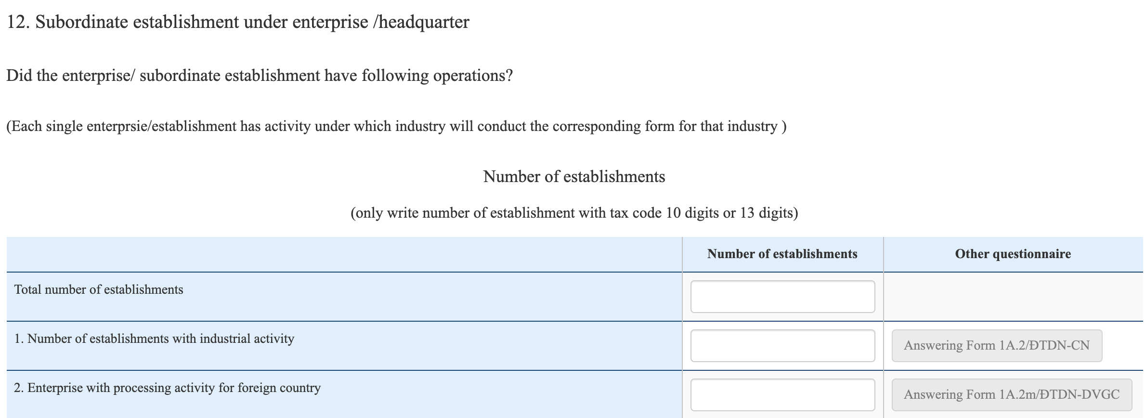
Merge html (01.html <-- 02.html, 03.html)
New Index_01.html
Index_01.html
<!-- 1st page start-->
<div id="INT_page_1" style="display: block;">
<div class="form-group form-inline" style="text-align:center;">
<span class="box-commentary"><span style="font-size:24px;">
QUESTIONNAIRE FOR<br>ENTERPRISE,COLLECTIVE<br>
…...
</div>
<!-- 2nd page start-->
<div id="INT_page_2" style="display: none;">
<div class="form-group form-inline" style="text-align:left;">
<span class="box-commentary">
<span style="font-size:20px;">
11. Energy consumption for production, business in 2019&zwnj;</span></span>
…...
</div>
<!-- 3rd page start-->
<div id="INT_page_3" style="display: none;">
<div class="form-group form-inline" style="text-align:left;">
<span class="box-commentary"><span style="font-size:20px;">
12. Subordinate establishment under enterprise/headquarter&zwnj;</span>
</div>
…...
</div>
<div class="form-group form-inline" style="text-align:center;">
<span class="box-commentary"><span style="font-size:24px;">
QUESTIONNAIRE FOR<br>ENTERPRISE,COLLECTIVE<br>
…...
</div>
Index_02.html
<div class="form-group form-inline" style="text-align:left;">
<span class="box-commentary">
<span style="font-size:20px;">
11. Energy consumption for production, business in 2019&zwnj;</span></span>
…...
</div>
Index_03.html
<div class="form-group form-inline" style="text-align:left;">
<span class="box-commentary"><span style="font-size:20px;">
12. Subordinate establishment under enterprise/headquarter&zwnj;</span>
</div>
…...
</div>

Slide 9

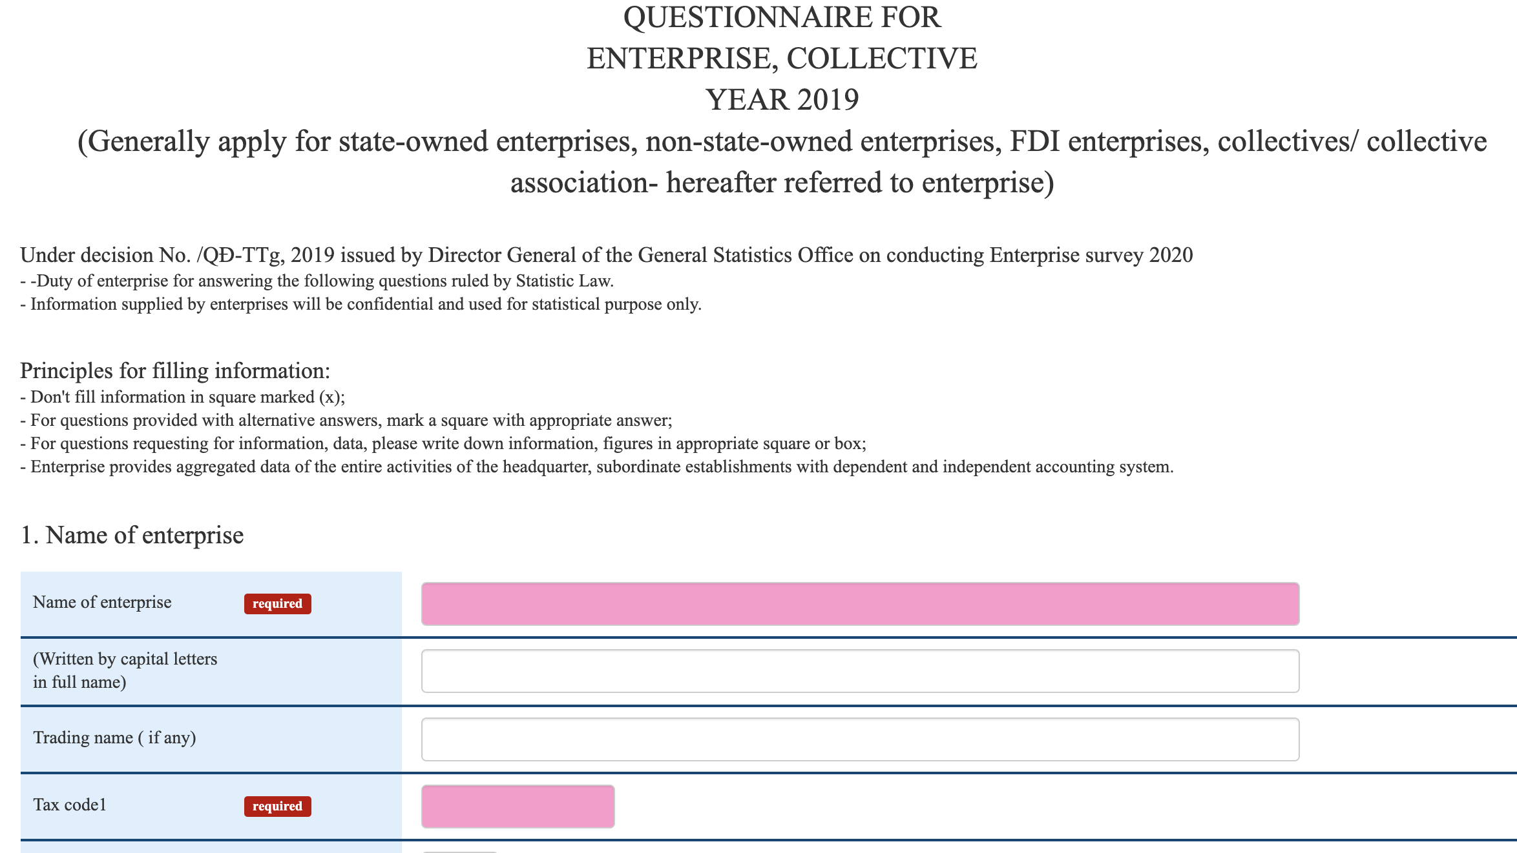
Merge html (01.html <-- 02.html, 03.html)
int_pager.js
function INT_pager(mode, page_no) {
switch (mode) {
case "first":
$("#INT_page_" + internal_page).css("display", "none");
$("#INT_page_1").css("display", "block");
internal_page = 1;
$("#INT_btn_1st").prop("disabled", true);
$("#INT_btn_f_1st").prop("disabled", true);
$("#INT_btn_prev").prop("disabled", true);
$("#INT_btn_f_prev").prop("disabled", true);
…….
break;
case "next":
$("#INT_page_" + internal_page).css("display", "none");
internal_page = internal_page + 1;
$("#INT_page_" + internal_page).css("display", "block");
$("#INT_btn_1st").prop("disabled", false);
…….
Index_01.html
<!-- Input item check -->
<button id="estb_btn_chk" type="button" class="btn btn-danger tokei-btn-command"
onclick="checkController(document.forms[0])">Item Check!</button>
<!-- First Page -->
<button type="button" class="btn btn-default tokei-btn-default btn-lg tokei-btn- command" id="INT_btn_1st" disabled
onclick="INT_pager('first')">First page</button>
…….
<!-- Next Page -->
<button type="button" class="btn btn-default tokei-btn-default btn-lg tokei-btn- command" id="INT_btn_next"
onclick="INT_pager('next')">Next page</button>
…….
</div>
Error on
1st page
chosahyo.js
err_status_1A = false;
err_page_1A = 1;
if (!(err_status_1A)) {
INT_pager('Page',err_page_1A); }
3rd page
1st page

